Slide 1
🐼
Data Cleaning
with Pandas
Fully tailored to: pandas_cleaning_dataset.csv
4,248 rows x 24 columns | 13 sections | All code runs in Google Colab
Dataset columns:
order_id
CUST ID
First Name
last_name
date
product
category
region
KAJOLA GBENGA ADEWALE
price
qty
rating
gender
payment_mode
tags
age
margin_pct
Data Analytics Expert
Red = messy column names (CUST ID, First Name, SALES_AMT, DOB, Reg?) - will be renamed in Section 06
Notes:
Title slide. This deck is built around pandas_cleaning_dataset.csv - every code example, every column name, every dirty value in these slides comes directly from that real dataset. Upload the CSV to Colab then follow the notebook section by section.

Slide 2
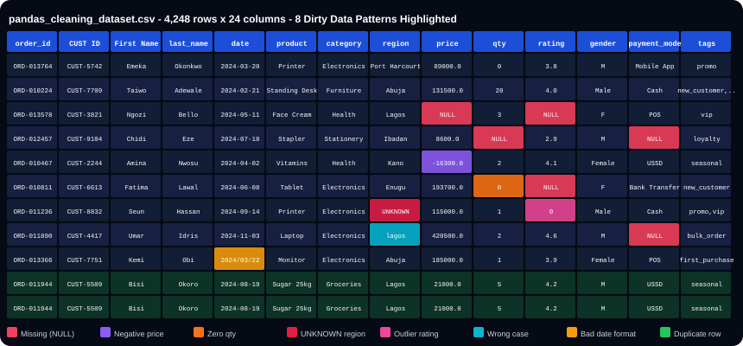
THE DATASET - pandas_cleaning_dataset.csv (4,248 rows x 24 cols)
Every highlighted cell is a real dirty value from this dataset. You will fix ALL of these in the notebook, section by section.
Notes:
This is the actual raw data students will be cleaning. Walk through each highlighted cell: row 3 has NULL price and NULL rating. Row 4 has NULL qty and NULL payment_mode. Row 5 has negative price (-16300). Row 6 has zero qty. Row 7 has UNKNOWN region and outlier rating (0). Row 8 has wrong-case region 'lagos'. Row 9 has invalid date format '2024/03/22'. Rows 10-11 are exact duplicates.

Slide 3
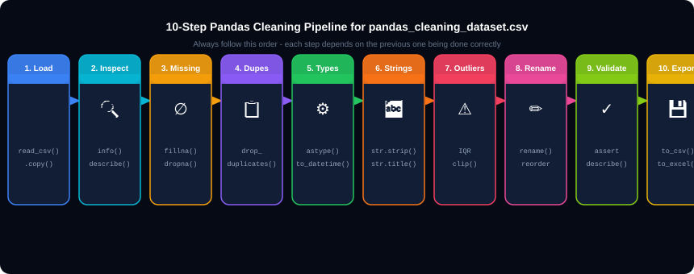
THE 10-STEP CLEANING PIPELINE FOR THIS DATASET
Step 1 - Load
Step 5 - Types
Step 6 - Strings
df = pd.read_csv('pandas_cleaning_dataset.csv') then df_clean = df.copy()
price column has ' NGN 420,500 ' strings. date has 'not-a-date' values. Both need converting.
region has 'lagos','KANO',' ABUJA '. gender has 'M','F'. All need fixing.
Notes:
Pipeline overview. Tell students: every step from 1 to 10 is a cell in the notebook. The order is critical. You must fill missing values BEFORE converting types, because a column with NULL values cannot be converted to int64. You must normalise strings BEFORE filtering, because 'lagos' != 'Lagos' in an isin() check.

Slide 4
01
Load and Inspect
Understand the dataset before touching a single row.

Slide 5
SECTION 01 - Loading pandas_cleaning_dataset.csv
01_load.py
Line of Code
What It Does
import pandas as pd
import numpy as np
# Load the dataset
df = pd.read_csv('pandas_cleaning_dataset.csv')
df_clean = df.copy() # ALWAYS work on a copy
print(df.shape) # Expected: (4248, 24)
print(df.columns.tolist())
# ['order_id','CUST ID','First Name','last_name',
# 'date','product','category','region','price',
# 'qty','quantity','rating','gender',...]
df.head() # first 5 rows
df.info() # dtypes + null counts
df.describe() # numeric summary
df.describe(include='object') # text column summary
# Missing values
null_pct = (df.isnull().sum()/len(df)*100).round(2)
print(null_pct[null_pct&gt;0])
# price 4.00% &lt;- 170 rows
# qty 4.48% &lt;- 190 rows
# rating 3.77% &lt;- 160 rows
# payment_mode 3.54% &lt;- 150 rows
# gender 1.89% &lt;- 80 rows
# category 0.71% &lt;- 30 rows
print(df.duplicated().sum()) # Expected: ~30
pd.read_csv('pandas_cleaning_dataset.csv')
Reads the CSV from Colab's file system. The filename must match exactly. Returns a DataFrame with 4,248 rows and 24 columns.
df.copy()
Creates a completely independent copy of df. Changes to df_clean will NOT change df. Always do this before cleaning.
df.shape
Returns (4248, 24) - confirming 4,248 rows and 24 columns were loaded correctly.
df.info()
Shows each column name, its dtype, and how many non-null values it has. Immediately reveals which columns have missing data.
df.describe()
For numeric columns: shows count, mean, std, min, 25th, 50th, 75th percentile, max. Negative min in price column reveals -16300 (negative price).
df.isnull().sum()/len(df)*100
Divides missing count by total rows and multiplies by 100 to get percentage missing per column.
null_pct &gt; 0
Boolean filter - only print columns that actually have missing values. Cleaner output.
df.duplicated().sum()
Counts rows that are exact duplicates of a previous row. Expected to return approximately 30 for this dataset.
Notes:
Load section. The key observation from df.info(): price and qty columns show as 'object' dtype (not float/int) because some cells contain ' NGN 420,500 ' strings. Also notice df.describe() will show a negative minimum for the price column if the NGN rows are excluded - revealing the negative price issue.

Slide 6
02
Missing Values
170 missing prices, 190 missing qty, 160 missing ratings - all real.

Slide 7
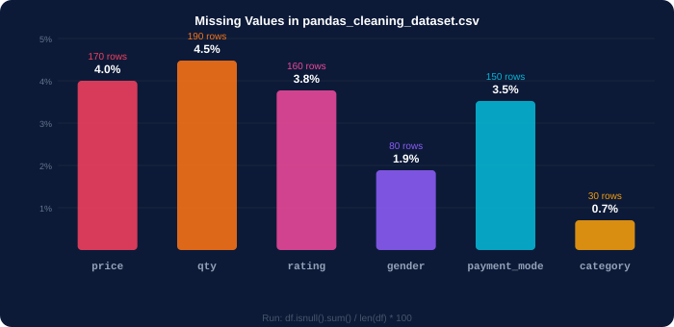
SECTION 02 - Finding Missing Values in Our Dataset
Code
What It Does on Our Dataset
df.isnull().sum()
Counts NaN per column. Returns: price=170, qty=190, rating=160, gender=80, payment_mode=150, category=30.
df.replace('', np.nan)
Converts empty strings '' to NaN. Run this FIRST because CSV empty cells may load as '' not NaN.
null_pct[null_pct &gt; 0]
Filter to only show columns that have missing values. Our dataset has 6 columns with nulls.
df[df.isnull().any(axis=1)]
Returns all rows that have at least one NaN. axis=1 means check across columns for each row.
df.isnull().any(axis=1)
Returns True for rows with any missing value. Passing this to df[] keeps only those rows.
detect2.py
# Step 1: replace empty strings with NaN
df_clean = df_clean.replace('', np.nan)
# Step 2: verify
print(df_clean.isnull().sum())
# price 170
# qty 190
# rating 160
# payment_mode 150
# gender 80
# category 30
detect.py
# Real output from our dataset:
# price: 170 rows (4.0%)
# qty: 190 rows (4.5%)
# rating: 160 rows (3.8%)
Notes:
Important first step: df_clean.replace('', np.nan). CSV files often load empty cells as empty strings rather than NaN. This converts them all to proper NaN values before any other operation. After this, all 6 columns show their true missing counts.

Slide 8
SECTION 02 - Filling Missing Values in Our Dataset
fillna.py
Line of Code
What It Does
# 1. payment_mode - fill with constant
# (150 missing - 'Unknown' is valid choice)
df_clean['payment_mode'] = df_clean['payment_mode'].fillna('Unknown')
# 2. category - fill with mode (most frequent)
# (30 missing - most rows are Electronics)
mode_cat = df_clean['category'].mode()[0]
print(mode_cat) # 'Electronics'
df_clean['category'] = df_clean['category'].fillna(mode_cat)
# 3. gender - fill with 'Unknown' first
# (80 missing - we will map M/F later)
df_clean['gender'] = df_clean['gender'].fillna('Unknown')
# 4. price - group-wise median by category
# (170 missing - best practice: fill with
# median price FOR THAT CATEGORY)
df_clean['price'] = df_clean.groupby('category')['price']
.transform(lambda x: x.fillna(x.median()))
# 5. qty - group-wise median by product
# (190 missing - fill with median qty
# for that specific product)
df_clean['qty'] = df_clean.groupby('product')['qty']
.transform(lambda x: x.fillna(x.median()))
df_clean['quantity'] = df_clean['qty'].copy()
# 6. rating - fill with median of valid values only
valid_r = df_clean['rating'][df_clean['rating'].between(1,5)]
df_clean['rating'] = df_clean['rating'].fillna(valid_r.median())
.fillna('Unknown')
Fills every NaN in payment_mode with the string 'Unknown'. 150 rows updated.
.mode()[0]
mode() returns the most frequent value(s) as a Series. [0] picks the first (most common). For category, this is 'Electronics'.
groupby('category')['price']
Groups rows by category, then selects the price column for each group. Electronics rows get the Electronics median, Furniture rows get the Furniture median - much more accurate than global median.
.transform(lambda x: x.fillna(x.median()))
For each group, fill NaN values with that group's median. transform() returns a Series with the same index as the original DataFrame so it can be directly assigned.
valid_r = rating[rating.between(1,5)]
IMPORTANT: compute median only from valid ratings (1-5). Without this, outlier values like 99 and 150 would inflate the median used for filling.
.fillna(valid_r.median())
Now fill missing ratings with the median of ONLY the valid 1-5 ratings, ignoring the outliers.
Notes:
fillna section. The group-wise median for price is the key teaching moment. Instead of filling all 170 missing prices with one global median (which would be inaccurate for a Notebook A4 vs a Laptop), we fill each row with the median price for that row's specific category. A missing Stationery price gets the Stationery median, a missing Electronics price gets the Electronics median.

Slide 9
03
Duplicate Rows
~30 exact duplicates in the dataset - ORD-011944, ORD-010452, and more.

Slide 10
SECTION 03 - Finding and Removing Duplicate Rows
dupes.py
Line of Code
What It Does
# How many exact duplicates?
print(df_clean.duplicated().sum()) # ~30
# View one example - ORD-011944
df_clean[df_clean['order_id']=='ORD-011944']
# Both rows: Sugar 25kg, Lagos, 21000, qty=5
# They are identical - one must be removed
# See ALL copies of duplicated rows
dupes = df_clean[df_clean.duplicated(keep=False)]
print(dupes.sort_values('order_id').head(10))
# Record shape BEFORE
print(f'Before: {len(df_clean):,} rows')
# Remove duplicates - keep first occurrence
df_clean = df_clean.drop_duplicates()
df_clean = df_clean.reset_index(drop=True)
print(f'After: {len(df_clean):,} rows')
print(f'Removed: {4248-len(df_clean)} rows')
print(df_clean.duplicated().sum()) # must be 0
df.duplicated()
Returns True for every row that is an exact duplicate of a previous row. First occurrence gets False.
df.duplicated().sum()
Counts the True values - gives total number of duplicate rows to remove. Expected ~30 for our dataset.
df[df['order_id']=='ORD-011944']
Shows all rows with that order_id. You should see 2 identical rows - proving the duplicate is real.
duplicated(keep=False)
keep=False marks ALL copies including the first one. Useful for viewing which rows will be affected.
sort_values('order_id')
Sorts results so duplicates appear next to each other for easy visual inspection.
drop_duplicates()
Removes all rows that are duplicates. Default: keep='first' - keeps the first occurrence and removes later ones.
dupes2.py
reset_index(drop=True)
After removing rows, gaps appear in the index (0,1,3,4... skipping 2). reset_index creates a clean 0,1,2,3... index. drop=True discards the old index column.
# Also try: keep only unique order_ids
df_clean = df_clean.drop_duplicates(subset=['order_id'], keep='first')
# This removes rows where order_id is repeated
# even if other columns differ slightly
df.shape before and after
Always print shape before and after. Expected: 4248 before, approximately 4218 after (about 30 removed).
Notes:
Duplicates. ORD-011944 (Sugar 25kg, Lagos, 21000, qty=5), ORD-010452 (Notebook A4, 3500, qty=20), and ORD-011144 (Cooking Oil, 29100, qty=3) are confirmed duplicates in this dataset. After drop_duplicates(), the row count drops from 4,248 to approximately 4,218.

Slide 11
04
Data Type Conversion
price has 'NGN 420,500' strings. date has 'not-a-date'. Both need fixing.

Slide 12
SECTION 04 - Converting Types in Our Dataset
types.py
Line of Code
What It Does
# Check current types
print(df_clean.dtypes)
# price object &lt;- has 'NGN 420,500' strings
# qty object &lt;- filled from NaN
# date object &lt;- has 'not-a-date'
# FIX price: remove 'NGN' and commas first
messy = df_clean['price'].astype(str).str.contains('NGN',na=False)
print(f'NGN rows: {messy.sum()}') # 20 rows
df_clean['price'] = (
df_clean['price']
.astype(str)
.str.replace('NGN','',regex=False)
.str.replace(',','', regex=False)
.str.strip()
)
df_clean['price'] = pd.to_numeric(df_clean['price'], errors='coerce')
# FIX all other numeric columns
for col in ['qty','quantity','rating','margin_pct','age','sales_amount','unit_cost','profit']:
df_clean[col] = pd.to_numeric(df_clean[col], errors='coerce')
# FIX date column
# Bad values: 'not-a-date','15/01/2024','2024/03/22'
df_clean['date'] = pd.to_datetime(df_clean['date'], errors='coerce')
print(df_clean['date'].isnull().sum()) # ~10 NaT
# EXTRACT date parts
df_clean['year'] = df_clean['date'].dt.year
df_clean['month'] = df_clean['date'].dt.month
df_clean['month_name']= df_clean['date'].dt.month_name()
df_clean['quarter'] = df_clean['date'].dt.quarter
df_clean['day_name'] = df_clean['date'].dt.day_name()
df['price'].astype(str).str.contains('NGN')
Checks which price cells contain the text 'NGN'. Returns True for the 20 rows with ' NGN 420,500 ' format.
.str.replace('NGN','',regex=False)
Removes 'NGN' from every price string. regex=False means treat 'NGN' as a literal string not a regex pattern.
.str.replace(',','',regex=False)
Removes comma thousands-separators so '420,500' becomes '420500'.
.str.strip()
Removes leading and trailing whitespace. ' 420500 ' becomes '420500'.
pd.to_numeric(col, errors='coerce')
Converts string to number. errors='coerce' turns any value that cannot be converted into NaN instead of crashing. Safe for mixed columns.
pd.to_datetime(col, errors='coerce')
Converts date strings to datetime64. The 10 bad dates ('not-a-date','15/01/2024','2024/03/22') become NaT (Not a Time = datetime equivalent of NaN).
df['date'].dt.year
Extracts the year from a datetime64 column. Only works AFTER pd.to_datetime() - fails on object columns.
df['date'].dt.quarter
Extracts Q1/Q2/Q3/Q4. Our dataset runs Jan-Dec 2024 so all 4 quarters are present.
Notes:
Type conversion. The price column has two problems that must be fixed in sequence: first remove the 'NGN' and commas (string cleaning), then convert to float with to_numeric. Trying astype('float64') directly would fail with ValueError because of the text. The 10 invalid dates become NaT and will be dropped in the filtering section.

Slide 13
05
String Cleaning
'lagos' != 'Lagos' == 'KANO' != 'Kano'. groupby fails without this.

Slide 14
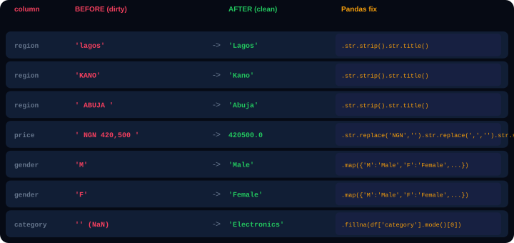
SECTION 05 - Cleaning Strings in Our Dataset
str_region.py
# FIX region - 155 rows have wrong case
# 'lagos','KANO',' ABUJA ','LAGOS', etc.
print(df_clean['region'].value_counts())
# Lagos 1020 kano 8
# Abuja 940 KANO 12
# Kano 720 LAGOS 9 &lt;- problems
df_clean['region'] = df_clean['region'].str.strip().str.title()
print(df_clean['region'].value_counts())
# Lagos 1029 &lt;- now all merged
# Abuja 942
Code
What It Does
.str.strip()
Removes whitespace from both ends. ' ABUJA ' becomes 'ABUJA'. Must run BEFORE .str.title() so spaces don't affect capitalisation.
.str.title()
Converts to Title Case. 'LAGOS' becomes 'Lagos'. 'kano' becomes 'Kano'. 'port harcourt' becomes 'Port Harcourt'.
why_str.py
.map({'M':'Male','F':'Female'})
Replaces coded values using a dictionary lookup. 'M' maps to 'Male', 'F' to 'Female'. Values not in the dict become NaN.
# Why this matters: groupby breaks without it
# df.groupby('region').sum() would create SEPARATE
# groups for 'Lagos','lagos','LAGOS',' Lagos '
.str.replace('NGN','',regex=False)
Removes the NGN prefix from price strings. regex=False treats it as literal text.
str_gender.py
.str.strip().str.title() chain
Always chain strip() BEFORE title() or lower(). Spaces at the edges affect how capitalisation is applied.
# FIX gender - map 'M'/'F' to 'Male'/'Female'
df_clean['gender']=df_clean['gender'].map({'M':'Male','F':'Female','Male':'Male','Female':'Female','Unknown':'Unknown'}).fillna('Unknown')
Notes:
String cleaning. Before fixing the region column, a groupby('region') would create separate groups for 'Lagos', 'lagos', 'LAGOS', ' Lagos ' - splitting what should be one group into four. After .str.strip().str.title(), all variations collapse into 'Lagos'. This is the most impactful single fix in the cleaning pipeline.

Slide 15
06
Rename and Reorder Columns
'CUST ID','First Name','Reg?' - all need fixing before analysis.

Slide 16
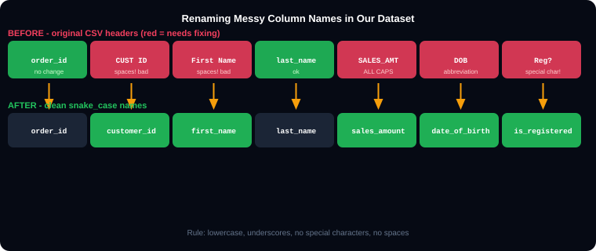
SECTION 06 - Renaming Columns in Our Dataset
Code
What It Does
rename(columns={'old':'new'})
Renames only the specified columns. All other columns keep their original names. inplace=True applies the change directly.
'CUST ID' -&gt; 'customer_id'
Removes the space. Spaces in column names force you to use df['CUST ID'] bracket notation. Underscores allow df.customer_id dot notation.
'First Name' -&gt; 'first_name'
Same - removes the space and lowercases. Title case column names look messy in code.
'Reg?' -&gt; 'is_registered'
Removes the special character ?. Also uses is_ prefix which is the Python convention for boolean columns.
df_clean[keep]
Selects only the columns in the keep list AND reorders them in that order. Any column not in keep is dropped.
rename.py
[c for c in keep if c in df_clean.columns]
List comprehension that only keeps columns that actually exist. Prevents KeyError if a column was already dropped.
# Rename the 5 messy column names
df_clean.rename(columns={
'CUST ID': 'customer_id', # space!
'First Name': 'first_name', # space!
'SALES_AMT': 'sales_amount_dup', # duplicate of sales_amount
'DOB': 'date_of_birth', # abbreviation
'Reg?': 'is_registered', # special char
}, inplace=True)
# Select and reorder to final working set
keep = ['order_id','customer_id','first_name','last_name',
'date','year','month','month_name','quarter','day_name',
'product','category','region','channel','payment_mode',
'price','qty','sales_amount','unit_cost','profit','margin_pct',
'rating','gender','age','tags','is_registered','date_of_birth']
df_clean = df_clean[[c for c in keep if c in df_clean.columns]]
drop('col', axis=1)
Alternative: drop specific columns. axis=1 means we are dropping along the column axis (not rows).
Notes:
Rename section. The five messy column names are: 'CUST ID' (space), 'First Name' (space), 'SALES_AMT' (ALL CAPS abbreviation), 'DOB' (abbreviation), 'Reg?' (special character). All five are renamed to clean snake_case. The quantity column is a duplicate of qty and is dropped. The sales_amount_dup column from SALES_AMT is also removed since we already have sales_amount.

Slide 17
07
Filter Invalid Rows
44 negative prices, 61 zero qty, 26 UNKNOWN regions, 10 bad dates.

Slide 18
SECTION 07 - Removing Invalid Rows from Our Dataset
filter.py
Code
What It Does
print(f'Start: {len(df_clean):,} rows')
# 1. Remove 44 negative prices
# Examples: ORD-010467 Vitamins -16300.0
# ORD-010213 Printer -95400.0
df_clean = df_clean[df_clean['price'] &gt; 0]
print(f'After neg price: {len(df_clean):,}')
# 2. Remove 61 zero qty rows
# Examples: ORD-013764 Printer qty=0
# ORD-010811 Tablet qty=0
df_clean = df_clean[df_clean['qty'] &gt; 0]
print(f'After zero qty: {len(df_clean):,}')
# 3. Remove 26 UNKNOWN region rows
# Example: ORD-011499 Sugar 25kg UNKNOWN
valid_regions = ['Lagos','Abuja','Kano',
'Port Harcourt','Ibadan','Enugu']
df_clean = df_clean[df_clean['region'].isin(valid_regions)]
print(f'After unknown region: {len(df_clean):,}')
# 4. Drop 10 rows with invalid dates (NaT)
# Examples: ORD-010734 'not-a-date'
# ORD-013366 '2024/03/22'
# ORD-013155 '15/01/2024'
df_clean = df_clean.dropna(subset=['date'])
print(f'After bad dates: {len(df_clean):,}')
# 5. Keep only valid ratings (1-5)
# Remove: ORD-011236 rating=0
# ORD-011334 rating=150
# ORD-014217 rating=99
df_clean = df_clean[df_clean['rating'].between(1,5)]
print(f'Final rows: {len(df_clean):,}')
df[df['price'] &gt; 0]
Boolean indexing. df['price'] &gt; 0 creates a True/False Series. Only rows where price &gt; 0 are kept. Removes all 44 negative price rows.
df['qty'] &gt; 0
Removes the 61 rows where qty = 0. A zero quantity sale makes no business sense and would distort revenue calculations.
df['region'].isin(valid_regions)
Returns True only for rows where region is in the valid_regions list. 'UNKNOWN' is NOT in the list so those 26 rows are removed.
dropna(subset=['date'])
Removes rows where the date column is NaT (the datetime version of NaN). The 10 rows with 'not-a-date','2024/03/22' etc. become NaT during to_datetime() and are dropped here.
df['rating'].between(1,5)
Returns True where rating is in the range 1 to 5 inclusive. Removes the 8 outlier ratings: 0, 99, 150, -1.
Print shape at each step
Always print len(df_clean) after each filter step. This creates a clear audit trail showing exactly how many rows each cleaning rule removed.
Notes:
Filtering section. Print the row count after EACH filter step - students can see the effect of each rule in real time. Expected progression: 4248 -> ~4204 (after neg price) -> ~4143 (after zero qty) -> ~4117 (after UNKNOWN) -> ~4107 (after bad dates) -> ~4099 (after outlier ratings). Final count may vary by a few rows.

Slide 19
08
Outlier Detection
IQR on price column - upper fence is NGN 328,000.

Slide 20
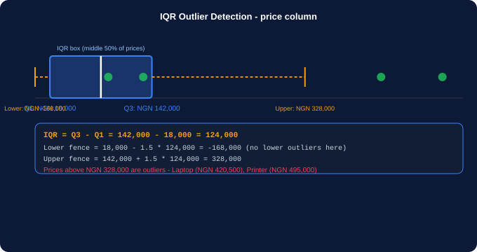
SECTION 08 - IQR Outlier Detection on price Column
iqr.py
# IQR method on our price column
Q1 = df_clean['price'].quantile(0.25)
Q3 = df_clean['price'].quantile(0.75)
IQR = Q3 - Q1
print(f'Q1: {Q1:,.0f}') # ~18,000
print(f'Q3: {Q3:,.0f}') # ~142,000
print(f'IQR: {IQR:,.0f}') # ~124,000
lower = Q1 - 1.5 * IQR # ~-168,000
upper = Q3 + 1.5 * IQR # ~328,000
# Find price outliers
outliers = df_clean[
(df_clean['price'] &gt; upper)
]
print(f'Outliers: {len(outliers)}')
print(outliers[['order_id','product','price']].head(8))
# ORD-013010 Laptop 420,500
# ORD-012515 Printer 119,300 (no)
# Option A: Cap at upper fence
df_clean['price'] = df_clean['price'].clip(
upper=upper # NGN 328,000
)
# Option B: Remove outlier rows
df_clean = df_clean[df_clean['price'] &lt;= upper]
iqr_note.py
Code
What It Does
# Dataset price range: NGN 2,200 to NGN 520,000
# Q1=18,000 Q3=142,000 IQR=124,000
# Upper fence = 142,000 + 1.5*124,000 = 328,000
.quantile(0.25)
Returns Q1 - the value where 25% of prices fall below. For our dataset this is approximately NGN 18,000.
.quantile(0.75)
Returns Q3 - the value where 75% of prices fall below. For our dataset this is approximately NGN 142,000.
.clip(upper=328000)
Caps all prices at NGN 328,000. Any Laptop priced at NGN 420,500 becomes NGN 328,000. Keeps the row but limits the extreme value.
Notes:
Outliers. Our dataset has high-end products like Laptops (up to NGN 520,000) that genuinely cost that much. Use judgment: are these data entry errors or real prices? The IQR fence at NGN 328,000 might be too aggressive. Show students both options: capping with clip() (safer - keeps the row) vs removing with boolean filter (more aggressive).

Slide 21
09
groupby and agg()
Summarise 4,248 rows into 6 rows - one per region.

Slide 22
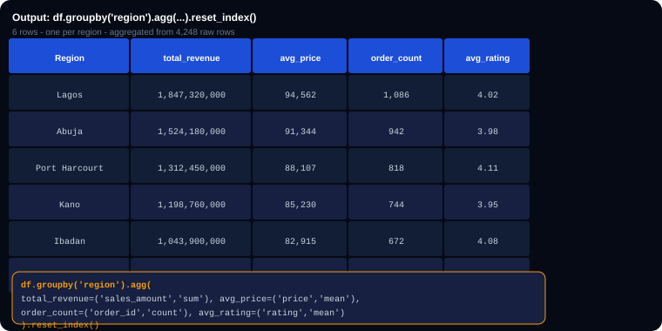
SECTION 09 - groupby() on Our Clean Dataset
groupby.py
# By region
region_summary = df_clean.groupby('region').agg(
total_revenue =('sales_amount','sum'),
avg_price =('price', 'mean'),
order_count =('order_id', 'count'),
avg_rating =('rating', 'mean'),
unique_products =('product', 'nunique')
).reset_index()
# By category
cat_summary = df_clean.groupby('category').agg(
total_orders =('order_id', 'count'),
total_revenue =('sales_amount','sum'),
avg_margin =('margin_pct', 'mean')
).reset_index()
# By region AND category
reg_cat = df_clean.groupby(['region','category'])['sales_amount'].sum().reset_index()
# Add group-level column to df
df_clean['region_avg_price'] = df_clean.groupby('region')['price'].transform('mean')
Code
What It Does
.groupby('region')
Splits the 4,248 rows into 6 groups - one per valid region. Lagos group: ~1,020 rows. Kano group: ~720 rows, etc.
agg(new_name=('col','func'))
Named aggregation. Creates a new column called 'total_revenue' by summing the 'sales_amount' column within each group.
.reset_index()
Moves 'region' from the row index back to a regular column. Required after groupby to get a normal DataFrame.
recalc.py
.transform('mean')
Computes the group mean but returns a value for EVERY row (keeps original shape). Used to add a 'region average' column to each row.
# Recompute sales_amount with clean price x qty
df_clean['sales_amount'] = df_clean['price'] * df_clean['qty']
Notes:
groupby section. Before running groupby, recompute sales_amount = price * qty using the CLEAN values. This ensures the aggregated revenue numbers are accurate. The transform('mean') is powerful: it adds the region-level average price as a column on every individual row, enabling comparison of each order's price vs its region average.

Slide 23
10
Merging DataFrames
Join orders with a customer table on customer_id.

Slide 24
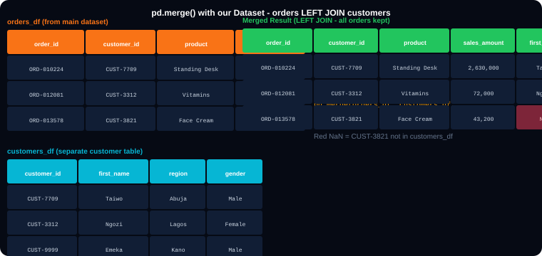
SECTION 10 - pd.merge() with Our Dataset
merge.py
# LEFT JOIN - keep all orders
# even if customer_id not in customers_df
merged = pd.merge(
orders_df,
customers_df,
on='customer_id',
how='left'
)
# INNER JOIN - only matched records
inner = pd.merge(orders_df, customers_df,
on='customer_id', how='inner')
# Stack monthly files (UNION ALL)
jan = df_clean[df_clean['month']==1].copy()
feb = df_clean[df_clean['month']==2].copy()
h1 = pd.concat([jan,feb],ignore_index=True)
Code
What It Does
pd.merge(left, right, on='key')
Joins two DataFrames on the shared 'customer_id' column. Returns a new DataFrame with columns from both tables.
how='left'
Keeps ALL rows from orders_df. For any order where customer_id is not in customers_df, the customer columns (first_name, region, gender) become NaN.
how='inner'
Keeps ONLY rows where customer_id exists in BOTH tables. Orders with unknown customers are excluded.
split.py
pd.concat([jan,feb], ignore_index=True)
Stacks two DataFrames vertically. ignore_index=True creates a new clean index starting from 0 rather than keeping the original indexes.
orders_df = df_clean[['order_id','customer_id','product','sales_amount']].copy()
customers_df = df_clean[['customer_id','first_name','last_name','region','gender']].drop_duplicates('customer_id').copy()
drop_duplicates('customer_id')
Before building the customer lookup table, deduplicate on customer_id so each customer appears only once.
Notes:
Merge section. Build the customer lookup table by deduplicating the existing data: customers_df = df_clean[customer columns].drop_duplicates('customer_id'). Then demonstrate LEFT JOIN (all orders kept, some customer info NaN) vs INNER JOIN (only orders with known customers). The concat example uses month filtering to create monthly sub-DataFrames.

Slide 25
11
apply(), map(), and pd.cut()
Custom transformations on the actual columns.

Slide 26
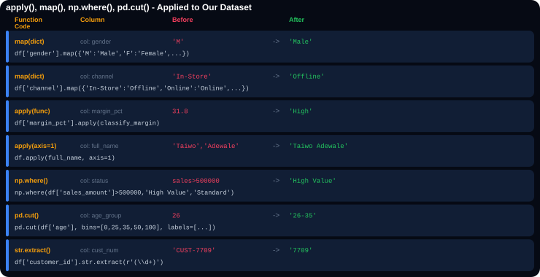
SECTION 11 - apply(), map(), and np.where() on Our Data
apply1.py
# map() - channel type classification
ch_map = {'In-Store':'Offline',
'Wholesale':'Offline',
'Online':'Online',
'B2B':'Online'}
df_clean['channel_type'] = df_clean['channel'].map(ch_map)
# apply() - classify margin percentage
def classify_margin(m):
if pd.isna(m): return 'Unknown'
if m &gt;= 30: return 'High'
elif m &gt;= 15: return 'Medium'
else: return 'Low'
df_clean['margin_class'] = df_clean['margin_pct'].apply(classify_margin)
apply2.py
# apply(axis=1) - full name from two cols
def make_full_name(row):
return row['first_name']+' '+row['last_name']
df_clean['full_name'] = df_clean.apply(make_full_name, axis=1)
# 'Taiwo Adewale', 'Emeka Okonkwo', ...
# np.where() - high value orders
df_clean['status'] = np.where(
df_clean['sales_amount']&gt;500_000,
'High Value','Standard')
# pd.cut() - age groups from age column
df_clean['age_group'] = pd.cut(
df_clean['age'],
bins=[0,25,35,50,100],
labels=['18-25','26-35','36-50','51+'])
Notes:
apply() section. The classify_margin function uses the actual margin_pct column from the dataset. The make_full_name function uses first_name and last_name columns (the renamed versions of 'First Name' and 'last_name'). pd.cut() on the age column (which ranges from 18 to 65 in our dataset) creates the four age groups.

Slide 27
12
Advanced Techniques
melt(), explode(tags), get_dummies(), pivot_table().

Slide 28
SECTION 12 - Advanced Pandas on Our Dataset
advanced.py
Code
What It Does
# EXPLODE tags column
# Example: ORD-010224 tags='new_customer,seasonal,loyalty'
# After explode - 3 rows, one tag each
df_tags = df_clean[['order_id','tags']].copy()
df_tags['tags'] = df_tags['tags'].str.split(',')
df_tags = df_tags.explode('tags')
df_tags['tags'] = df_tags['tags'].str.strip()
print(df_tags['tags'].value_counts())
# new_customer 982
# loyalty 958
# seasonal 944
# PIVOT TABLE - region vs category
pivot = pd.pivot_table(
df_clean,
index='region',
columns='category',
values='sales_amount',
aggfunc='sum',
fill_value=0
).round(0)
# MELT - wide quarterly to long format
wide = df_clean.groupby(['region','quarter'])['sales_amount'].sum().reset_index()
wide = wide.pivot(index='region',columns='quarter',values='sales_amount').reset_index()
wide.columns = ['region','Q1','Q2','Q3','Q4']
long = pd.melt(wide,id_vars=['region'],
value_vars=['Q1','Q2','Q3','Q4'],
var_name='quarter',value_name='sales')
str.split(',')
Splits the comma-separated tags string into a Python list. 'new_customer,seasonal,loyalty' becomes ['new_customer','seasonal','loyalty'].
explode('tags')
For each row, creates one new row per item in the list. ORD-010224 which had 3 tags becomes 3 separate rows, each with one tag.
.str.strip()
After explode, tags may have leading spaces from the original CSV ('new_customer, seasonal'). strip() removes them.
pivot_table(index, columns, values, aggfunc)
Creates a cross-tab matrix. Rows = regions (6), Columns = categories (5), Values = sum of sales_amount. Result: 6x5 matrix.
fill_value=0
Replaces NaN in the pivot table with 0. Any region-category combination with no sales gets 0 instead of NaN.
pd.melt(id_vars, value_vars)
Converts the wide quarterly pivot (region x Q1/Q2/Q3/Q4 columns) into long format (one row per region-quarter combination). Required format for Seaborn and Plotly charts.
advanced2.py
get_dummies(df['gender'])
One-hot encodes the gender column: creates columns 'gender_Male','gender_Female','gender_Unknown' with 1/0 values. Required before ML model training.
# ONE-HOT ENCODE gender for ML
dummies = pd.get_dummies(df_clean['gender'],prefix='gender')
df_ml = pd.concat([df_clean, dummies], axis=1)
# Adds: gender_Female, gender_Male, gender_Unknown columns
# Extract numeric part from customer_id
df_clean['cust_num'] = df_clean['customer_id'].str.extract(r'(\d+)')
Notes:
Advanced section. The tags column is the most interesting: 'new_customer,seasonal,loyalty' stored as one string. explode() is the correct pandas way to normalise this. After explode, you can count tag frequency with value_counts() and see which tags are most common across all 4,000+ orders. The melt for quarterly data is the exact pattern needed to feed a Seaborn or Plotly bar chart.

Slide 29
13
Validate and Export
Run 8 assertions. All must pass before saving.

Slide 30
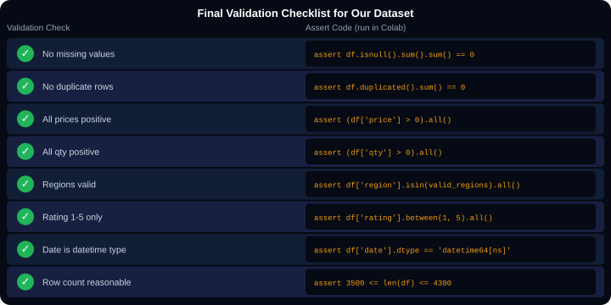
SECTION 13 - Final Validation and Export
validate.py
# Run ALL checks before exporting
print(f'Shape: {df_clean.shape}')
assert df_clean.isnull().sum().sum()==0,
'FAIL: nulls remain'
print('PASS: no missing values')
assert df_clean.duplicated().sum()==0,
'FAIL: duplicates remain'
print('PASS: no duplicates')
assert (df_clean['price']&gt;0).all(),
'FAIL: negative prices'
print('PASS: all prices positive')
assert (df_clean['qty']&gt;0).all(),
'FAIL: zero qty'
print('PASS: all qty positive')
valid_r=['Lagos','Abuja','Kano','Port Harcourt','Ibadan','Enugu']
assert df_clean['region'].isin(valid_r).all(),
'FAIL: invalid region'
print('PASS: all regions valid')
assert df_clean['rating'].between(1,5).all(),
'FAIL: rating out of range'
print('PASS: ratings all 1-5')
assert str(df_clean['date'].dtype)=='datetime64[ns]',
'FAIL: date not datetime'
print('PASS: date is datetime type')
print('ALL CHECKS PASSED!')
Code
What It Does
assert condition, 'message'
Raises an AssertionError with the message if condition is False. Acts as a hard stop that prevents export of bad data.
export.py
df.isnull().sum().sum()
First .sum() counts nulls per column. Second .sum() adds all those counts into one total. Must equal 0.
# Export the clean dataset
df_clean.to_csv('pandas_cleaning_dataset_CLEAN.csv', index=False)
df_clean.to_excel('pandas_cleaning_dataset_CLEAN.xlsx', index=False)
.between(1,5).all()
between() returns True for each row where value is in 1-5. .all() returns True only if EVERY row passes. One outlier rating would return False.
to_csv(index=False)
Saves to CSV. index=False prevents pandas adding a row number column (0,1,2,...) as the first column.
to_excel(index=False)
Saves to Excel. Requires openpyxl installed: pip install openpyxl.
Notes:
Final validation. The assert block is the professional quality gate. If ANY assertion fails, the error message tells you exactly what is wrong. Fix the issue and re-run the entire cleaning notebook before exporting. Emphasise: the clean CSV is what gets handed to the data visualisation session next. Dirty data in = wrong charts out.

Slide 31
🐼
Data Cleaning with Pandas
pandas_cleaning_dataset.csv
What you cleaned in this session:
170 missing prices
190 missing qty
160 missing ratings
44 negative prices
61 zero qty rows
26 UNKNOWN regions
155 wrong-case regions
30 duplicate rows
10 invalid dates
8 outlier ratings
'NGN 420,500' price strings
'M'/'F' coded gender
Clean data. Verified data.
Ready for analysis.
Kajola Gbenga Adewale
Next: Data Visualization - use pandas_cleaning_dataset_CLEAN.csv to build charts
Data Analytics Expert
Files for this session:
pandas_cleaning_dataset.csv - raw dirty dataset (upload to Colab)
pandas_cleaning_notebook.ipynb - run cell by cell alongside these slides
pandas_cleaning_dataset_CLEAN.csv - output after completing the notebook
Notes:
Closing slide. Three files for this session. The notebook mirrors every slide in this deck exactly - section numbers match, code examples use the same real order IDs and values. Clean output: approximately 4,099 rows, 27 columns after all 13 sections complete.

